Slide 1

Analysis On Rental Houses
Team Members
Tella Krishna Prasad
G. Rakesh

Slide 2
PROBLEM STATEMENT
When individuals arrive in Hyderabad and require accommodation for rental houses, accessing our data will provide them with valuable insights into house prices, expenses, sizes, and locations. This information will assist them in forming expectations and making informed decisions about their housing needs.

Slide 3
Introduction
In Hyderabad's dynamic rental housing market, newcomers face the challenge of finding suitable accommodation. Our data offers valuable insights into house prices, expenses, sizes, and locations, aiding individuals in making informed decisions. By accessing this information, newcomers can navigate the rental market with confidence, ensuring a smoother transition to life in Hyderabad.

Slide 4
Objective
The classification goal is to predict if the customer will inverest in a Rental Houses. By predicting it we can help the customer to make work easier ,productive ,efficient and faster. Indirectly we can save their money. The goal is to target those customers who are likely interested in taking the rental houses.

Slide 5
Web Scraping
1. Web scraping is a software technique of extracting information from the website it takes the unstructured data into structured data that can be stored and analyzed.
2. We have to send request to the url of the webpage we want to access. The server responds to the request by returning the html content of the webpage. If we get the staus code as 200 we can scrap the HTML context from webpage.
3. Beautiful soup is a python library that makes easy to scrape information and exacting the data from HTML files.
Website : Makaan.com
URL LINK: https://www.makaan.com/hyderabad-residential-property/rent-property-in-hyderabad-city

Slide 6







LIBRARIES
Pandas
Numpy
Seaborn
Requests
Matplotlib
Regex
BeautifulSoup

Slide 7
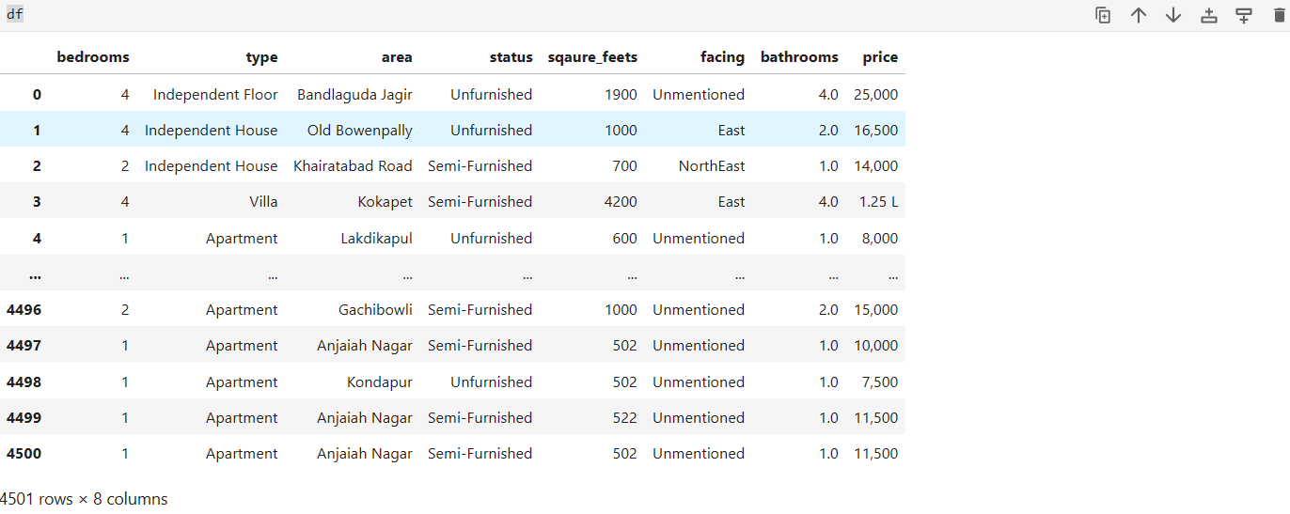
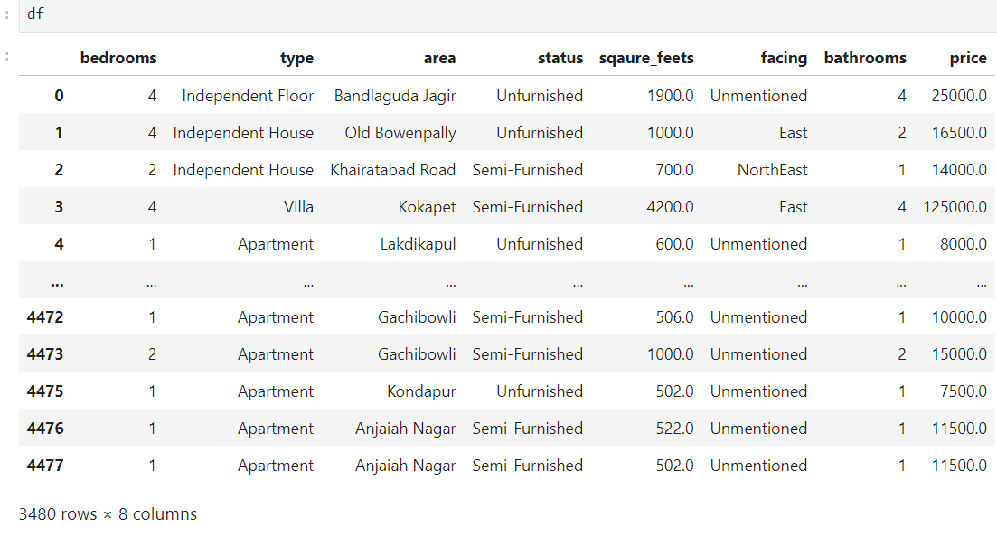
Data Cleaning Process
Removing special characters.
Units conversation.
Identifying & imputing of missing values.
Type casting.
Drop the duplicate column.
Raw Data
Cleaned Data

Slide 8
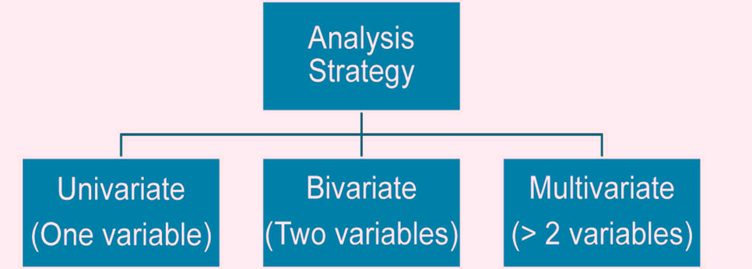
Data Visualization
3. MULTI - VARIATE:
Categorical-Numerical-Categorical
Categorical-Numerical-Numerical
Categorical-Categorical-Categorical
Numerical-Numerical-Numerical
2. BI-VARIATE:
Categorical-Numerical
Numerical-Numerical
Categorical-Categorical
1. UNI-VARIATE:
Single numerical
Single categorical

Slide 9
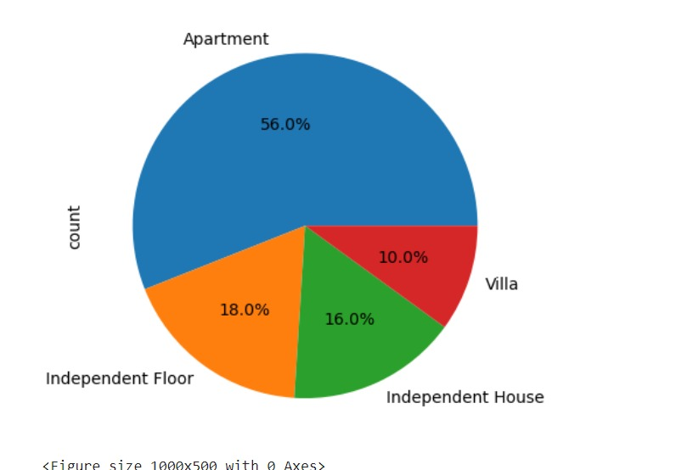
Percentage of Type
The pie chart depicts the distribution of rental housing types in Hyderabad. It indicates that rental apartments constitute the highest percentage at 56%, while villas represent the lowest percentage at 10%.

Slide 10

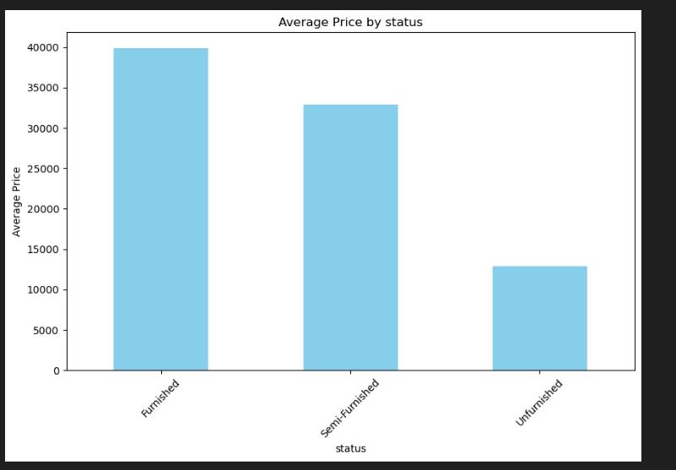
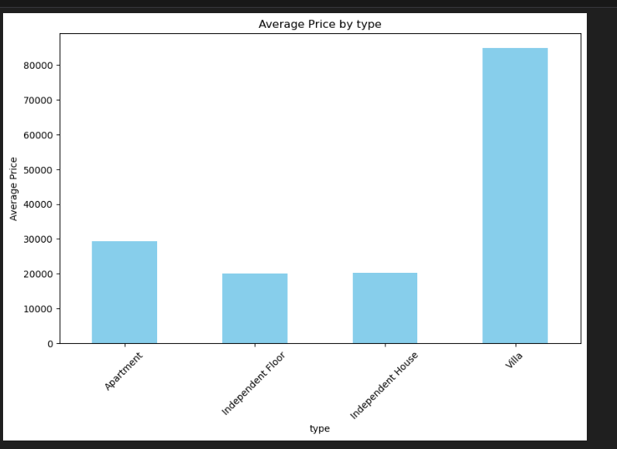

Average of Status & type
The bar graph illustrates the average rental prices of houses categorized by their furnishing status, including furnished, semi-furnished, and unfurnished..
The bar graph illustrates the average price of rental houses categorized by type, including independent houses, apartments, villas, and independent floors.

Slide 11
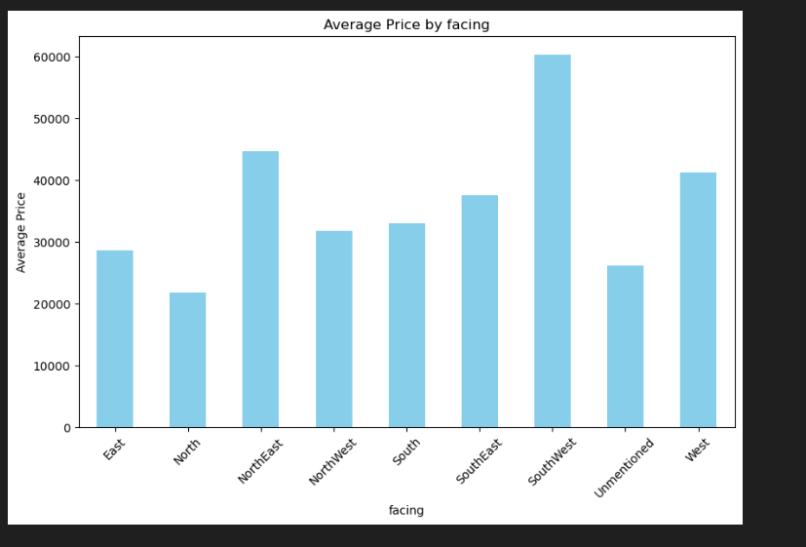
Average of facing
The bar graph illustrates the average rental house prices based on the facing direction. Southwest-facing houses command the highest average price, while north-facing houses have the lowest average price.
Everest Cantu
Ceo Of Ingoude Company
Ceo Of Ingoude Company
Ceo Of Ingoude Company

Slide 12
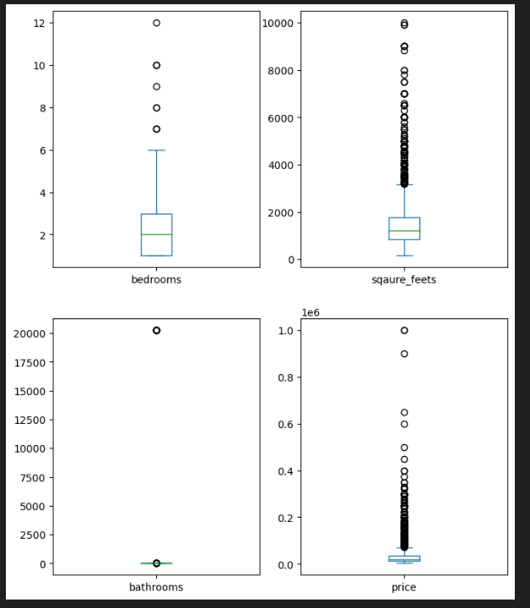
BOX PLOTS
This box plot is used to
identify outliers. While
there are numerous
outliers present in the
plot, it is important to
note that all of these
outliers are genuine
values, and thus, they
have been retained in
the analysis.

Slide 13
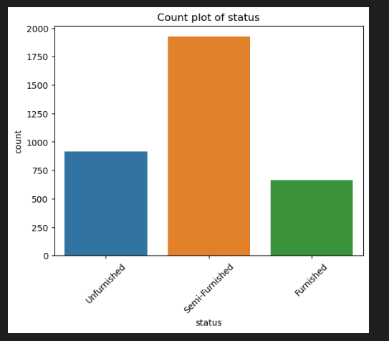
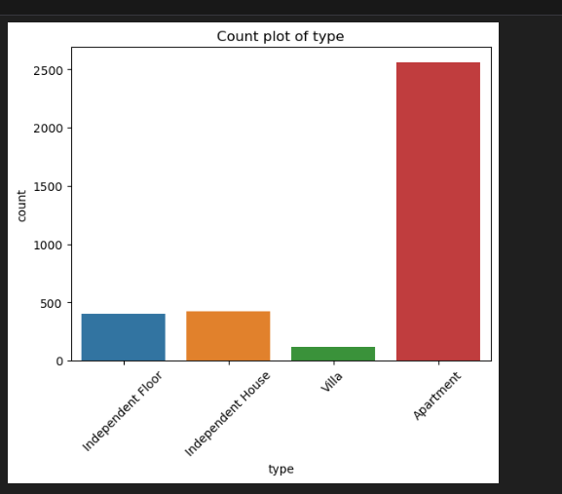
Count of Status & Type
The count plot from the Makaan dataset illustrates that apartment houses have the highest number of occurrences, while villas have the lowest count.
The count plot displays the distribution of furnishing statuses in the Makaan dataset. According to the plot, semi-furnished houses have the highest count, while fully furnished houses have the lowest count.

Slide 14
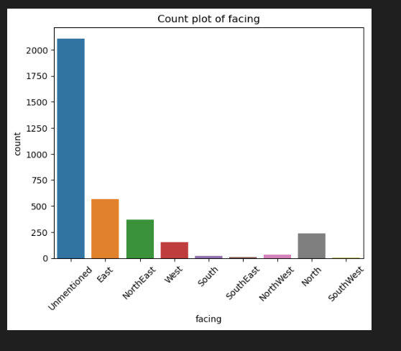
COUNT PLOT Of Facing
The count plot in the Makaan dataset displays the frequency of houses based on their facing direction. In this plot, east-facing houses have the highest count, while southeast-facing houses have the lowest count.

Slide 15
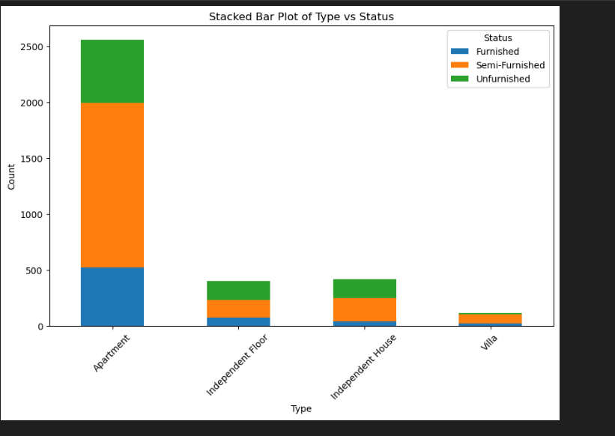
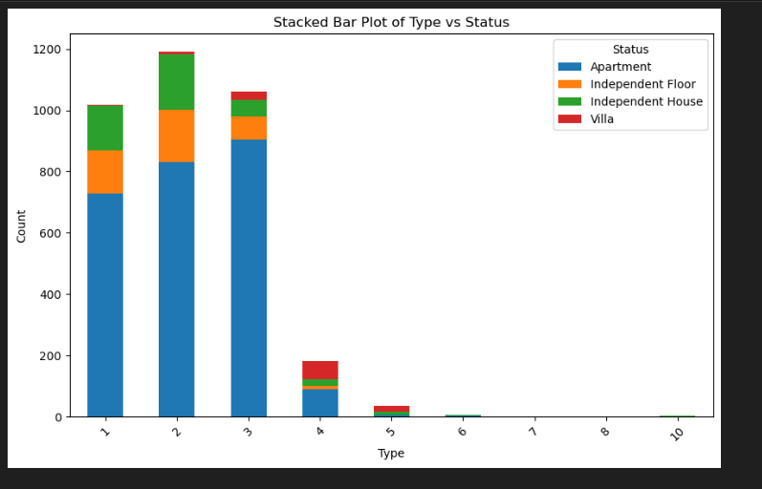
STACKED BAR PLOT Of Type & Status
This stacked group bar plot displays the count of houses, illustrating the relationship between the number of bedrooms and the status of each house.
The stacked bar group plot is used to visually represent categorical data where multiple variables are stacked on top of each other within each category. This stacked group bar plot illustrates the distribution of houses based on both their type and status.

Slide 16
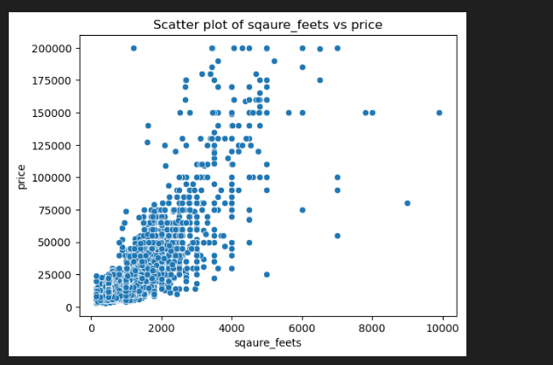
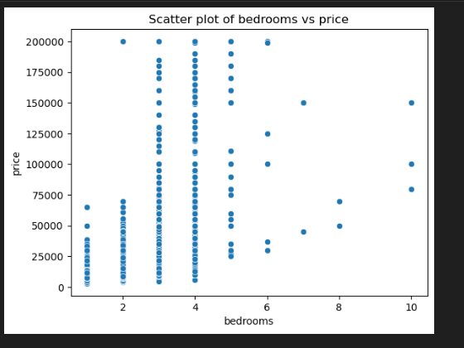
Scatter Plots
The scatter plot illustrates the relationship between two numerical variables, specifically the number of bedrooms and the price of the house. It suggests that there is a slight tendency for the price of the house to increase as the number of bedrooms increases.
The scatter plot indicates a relationship between two numerical variables. Specifically, it suggests that as the square footage increases, the price of the house also tends to increases.

Slide 17
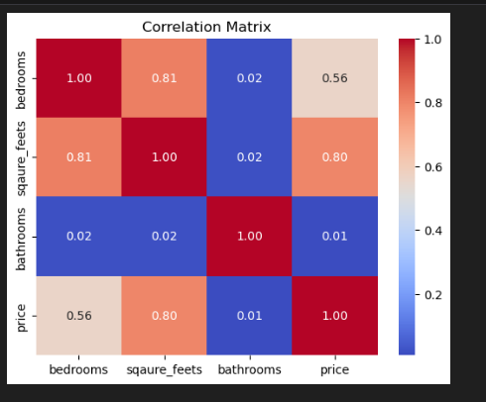
A correlation matrix shows the relationships between multiple variables in a dataset by calculating the correlation coefficient between each pair of variables . From above correlation matrix, it appears that there is a positive correlation between square feet and price, square feet and number of bedrooms, as well as between price and number of bedrooms. This suggests that as any one of these variables increases, the others also tend to increase.
CORRELATION MATRIX

Slide 18
CONCLUSION
Our data offers a comprehensive resource for individuals seeking rental accommodation in Hyderabad. By providing insights into house prices, expenses, sizes, and locations, we enable them to make informed decisions aligned with their housing needs. With this valuable information at their disposal, individuals can approach their housing search with confidence and clarity, ensuring a smoother transition to life in Hyderabad.

Slide 19


Slide 20


